Slide 1


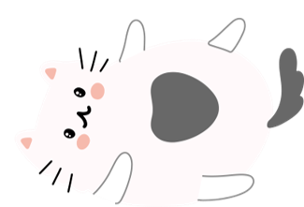
Cat Connect
Ali Mussayab, Anna Ronnhed, Jakob Håkonsson and Paul Vinegren
Stockholm University Kista

Slide 2
Introduction
Emerging market in IoT solutions for pets
Today
Live feed cameras
Smart bowls
Tomorrow
Complete solutions

Slide 3
Connection to IoT
Smart home context
Transparency and knowledge about the home
User is both human and cat
Components
Raspberry Pi
MQTT publish and subscribe protocol
Sensors and actuators read and controlled through an app

Slide 4
Project goals
The system will sense that a cat’s bowl is empty and send a notification to a mobile android app used by the owner of the cat.
The system will use a feeder that can be activated by the user through the mobile app to ensure the cat is fed at the correct times with the capacity of up to 2 meals.
The system will use a laser pointer that can be activated by the user through the mobile app that would run for a time period.

Slide 5
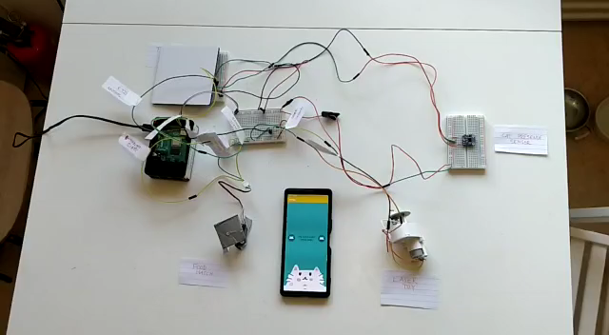
Results - Input

Slide 6
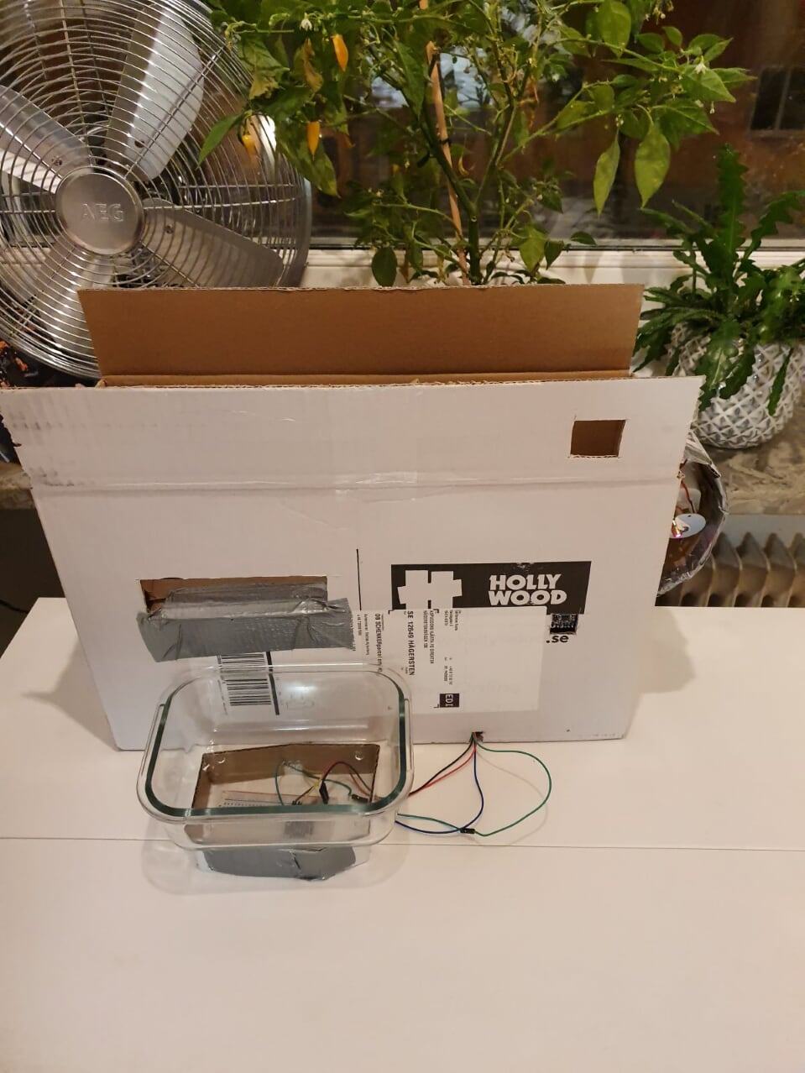
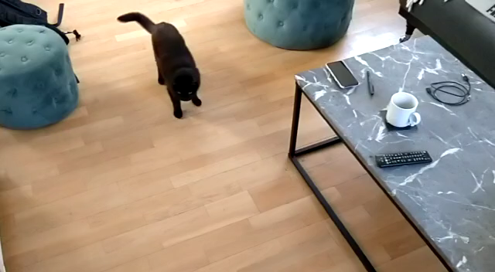
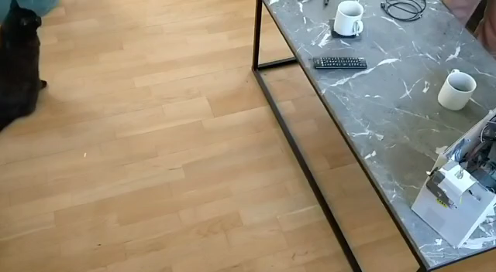
Results - playing

Slide 7
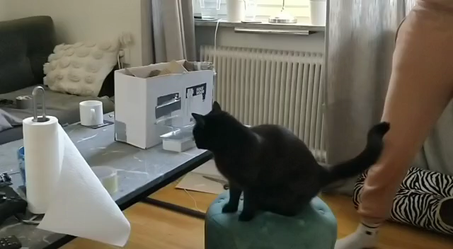
Results - feeding

Slide 8
Conclusion and discussion
Not an engaging enough toy for cats to play with, they get bored of the repeated pattern quickly.
Even though we got our prototype to work it became apparent that it would not be functional in a real-life situation
How to create engaging IoT toys for cats?

Slide 9
Future work
Smart Home
Auto Feeding
Auto Activation of the Auto Feeder
Modular Multi Feeders
More advance laser with AI and camera
Multipurpose

Slide 10
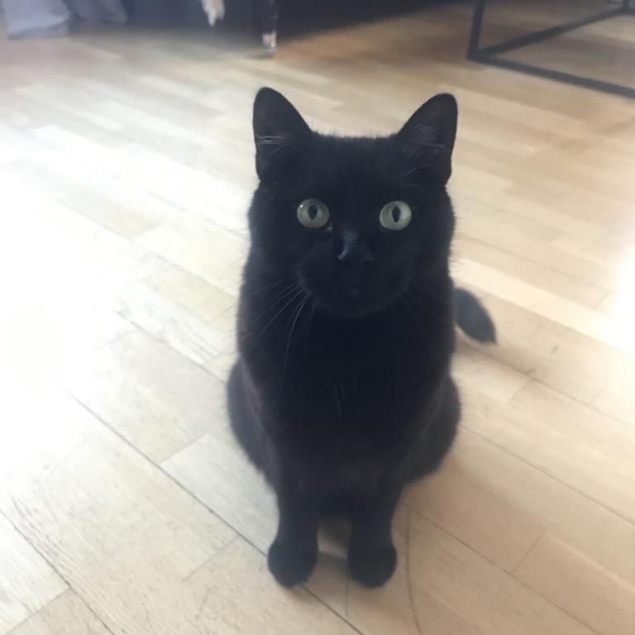
Questions?

